Slide 1
Project Proposal – GFP Dataset
DATA ANALYSIS 2023
17.05.2023
A presentation by: ​ Angela Ma, Roman Kurley, Lisa Duttenhöfer, Rebecca Ress

Slide 2
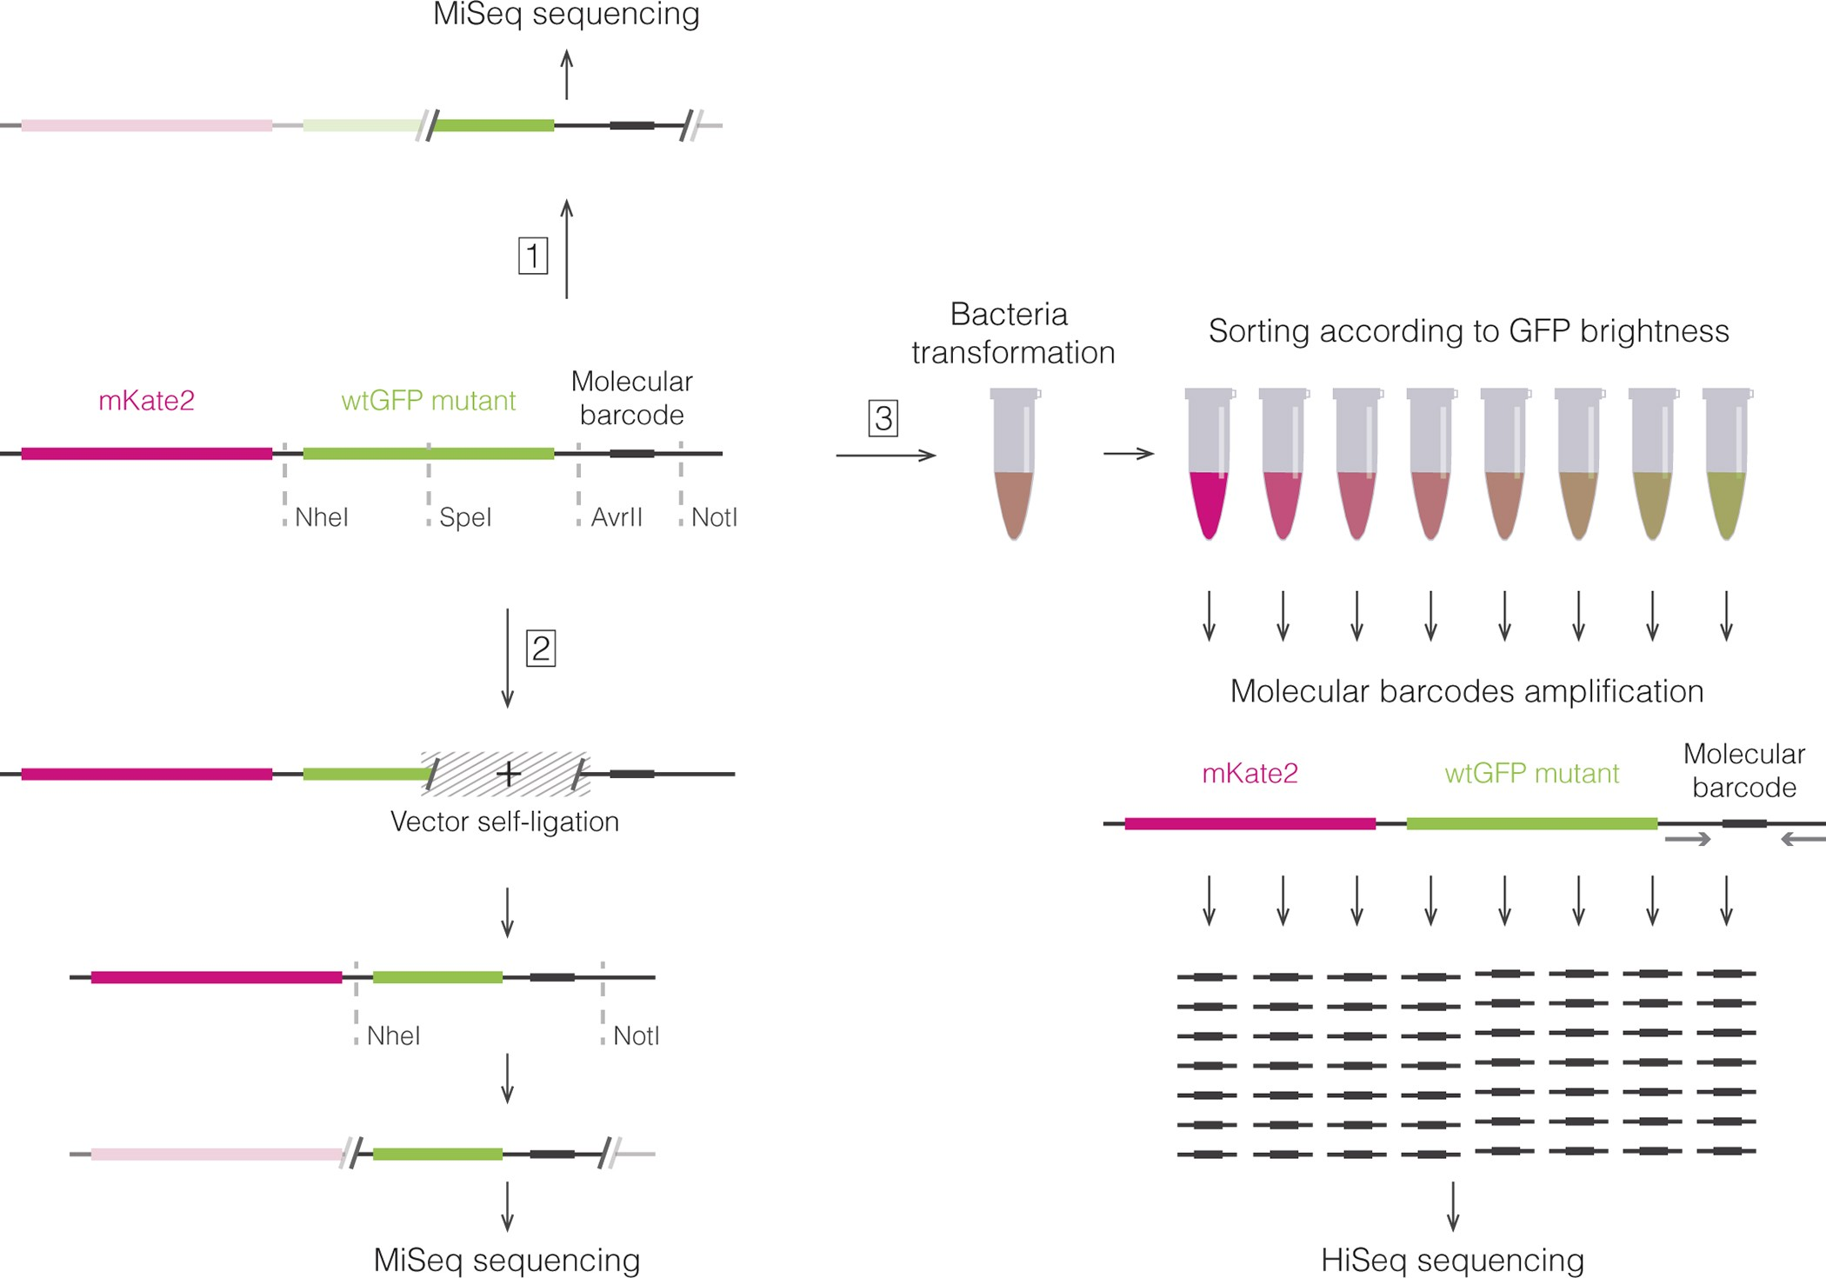
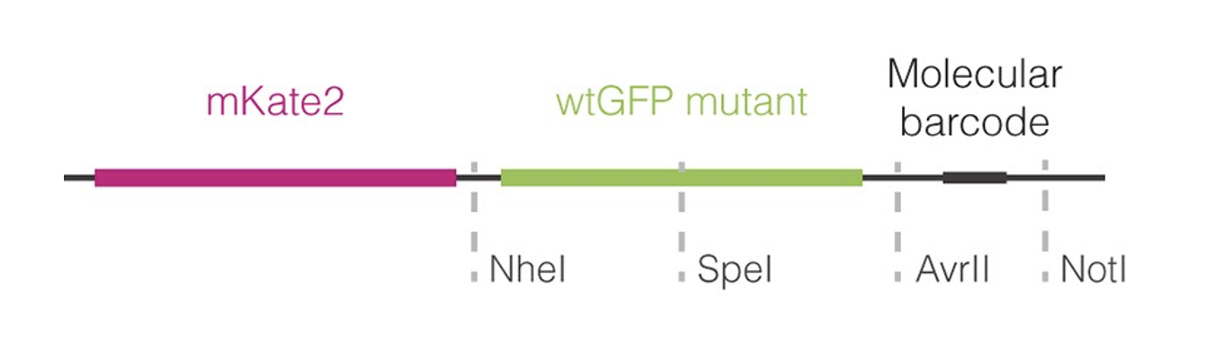
Methods
error-prone PCR
FACS
Sarkisyan et al. 2016

Slide 3
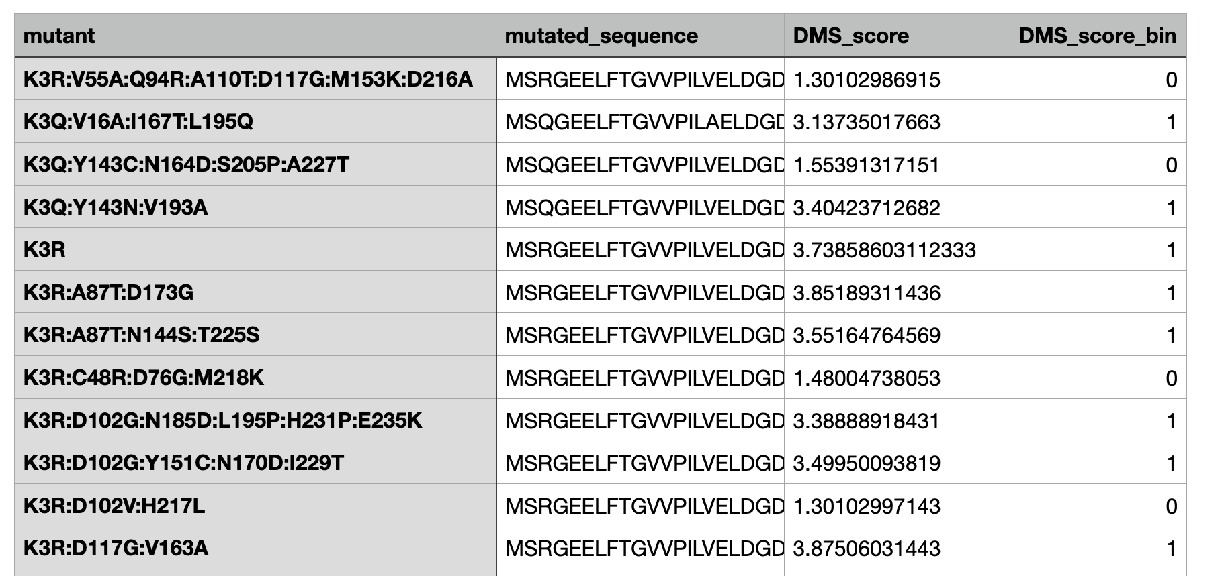
Data and Limitations
few single mutations
almost perfect protein → optimization nearly impossible
Sarkisyan et al. 2016

Slide 4
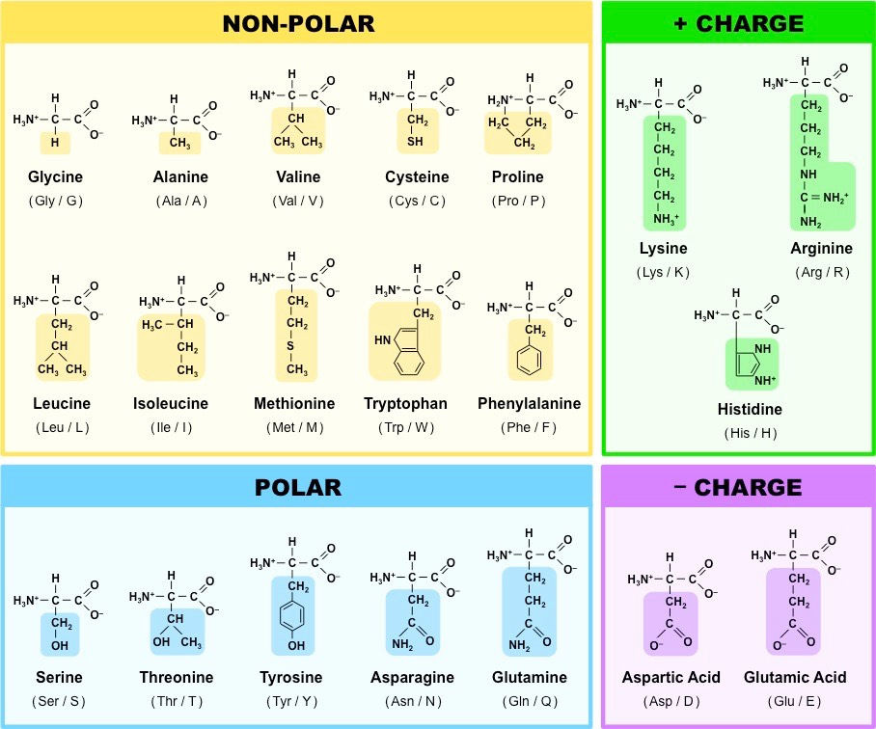
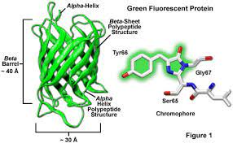
What we want to achieve
what we want to achieve
Insights
Improvement vs. Deterioration
Hotspots & Patterns
Further Analysis
https://zeiss-campus.magnet.fsu.edu/articles/probes/fpintroduction.html
https://ib.bioninja.com.au/standard-level/topic-2-molecular-biology/24-proteins/amino-acids.html
Notes:
1) (KLICK) First gain general insights into the data + basic analysis
2) (KLICK) Following that up, find trends for improvement of protein function/deterioration
•Take advantage of the fact that we have DMS_data containing 1-12 mutations à multilayered mutational depth
•(KLICK) Patterns between AA-properties (charge, hydrophilicity) and the visible effect to the protein
3) (KLICK) With this, move to the analysis of mutational hotspots, so focussing on a region with interesting/clear mutational results.
•(KLICK) Example: chromophore as a mutational site
•Clustering of mutations that have a similar influence on the fitness and then see, which properties the original AA had and what the new have, and compare that with the respective position of the AA in the protein.
•Try to create a prediction model and evaluate its accuracy 4) Lastly, once all of this has been completed, we would like to take the project even further.

Slide 5
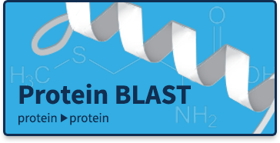
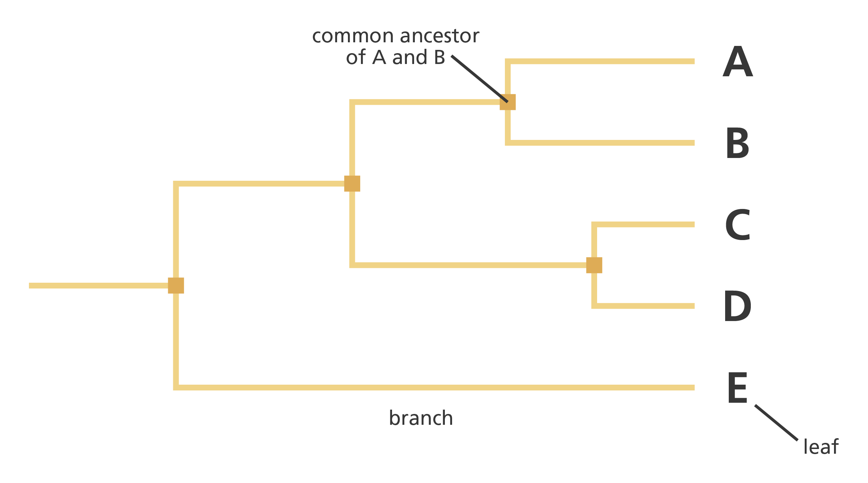



The direction we want to take the project
The direction we want to take the project
Further Analysis
Interactions
3D-Structure
Phylogeny
Interactions
1) GFP as a marker
2) New linking possibilities
→ More data required
1) Combination of mutations
2) Decrease in size/mass
3) Long-range Interactions
1) Evolutionary steps
2) Site conservation
3) Pairwise alignment/MSA
https://blast.ncbi.nlm.nih.gov/Blast.cgi
https://bioconda.github.io/
https://techcrunch.com/2021/07/22/deepmind-puts-the-entire-human-proteome-online-as-folded-by-alphafold/?
https://www.rcsb.org/
Notes:
Based off of how much time we have left and what we discover in the data, we have 3 different options of what we can do further.
Interactions:
Reason: GFP is commonly used as a marker e.g. on a plasmid
Explore new linkage possibilities
Negative: way more data is required and this would get very complex very fast
2) 3D-Structure:
Reason: Make use of the different amounts and combinations of mutations and we already know a very important domain: the chromophore
Analyse long-range interactions (physical distance) and understand the influence on 3D-structure
Look at a possible reduction of size/mass by deleting unnecessary AA
Use Protein data base (1 entry) and alphafold (if there is time)
Negative: very low mutational tolerance!!
3) Phylogeny:
Reason: GFP has highly conserved sequences.
How do these mutations compare to evolutionary conservation across different species?
EPISTASIS
First use pairwise alignments and then upgrade to MSA.
Usage of BLAST software for MSA-scores and creating phylogenetic trees
Maybe there were different evolutionary approaches of different species that in the end converged to 1 superior sequence of GFP
Need to learn: Implementation of a new python module „bioconda“
AlphaFold und sind tiefe neuronale Netze aus Transformern, welche eine Proteinstruktur basierend auf der Aminosäuresequenz des Proteins vorhersagen
bioconda is a conda channel, that contains the names, locations and dependencies of many bioinformatics tools. Used for computational biology to install packages
Work with C++ blast in python
Pip only used for python packages, but bioconda installs you everything
Bioconda lets you install Python Packages and all the other non-python tools and their dependencies with one single command.

Slide 6
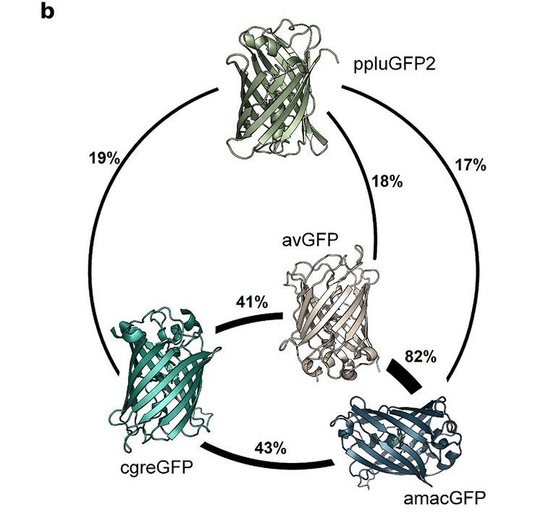
Our final goal
Our final goal
Understand evolutionary path
Evaluate different effects in the mutational history
Visualize the results
https://elifesciences.org/articles/75842
Notes:
Gain a deeper understanding of the evolutionary convergence of the Amino acid sequence of GFP and evaluate the mutational effect at different positions within the protein. Use multiple levels of mutational depth.
2) Work beyond our given dataset by using other software and combining both outputs
3) Create strong visualizations of our data
Explain figure as example
Amino acid sequence identity between different orthologs, displayed in percent.
Two segments of DNA can have shared ancestry because of three phenomena: either a speciation event (orthologs), or a duplication event (paralogs), or else a horizontal (or lateral) gene transfer event (xenologs).

Slide 7
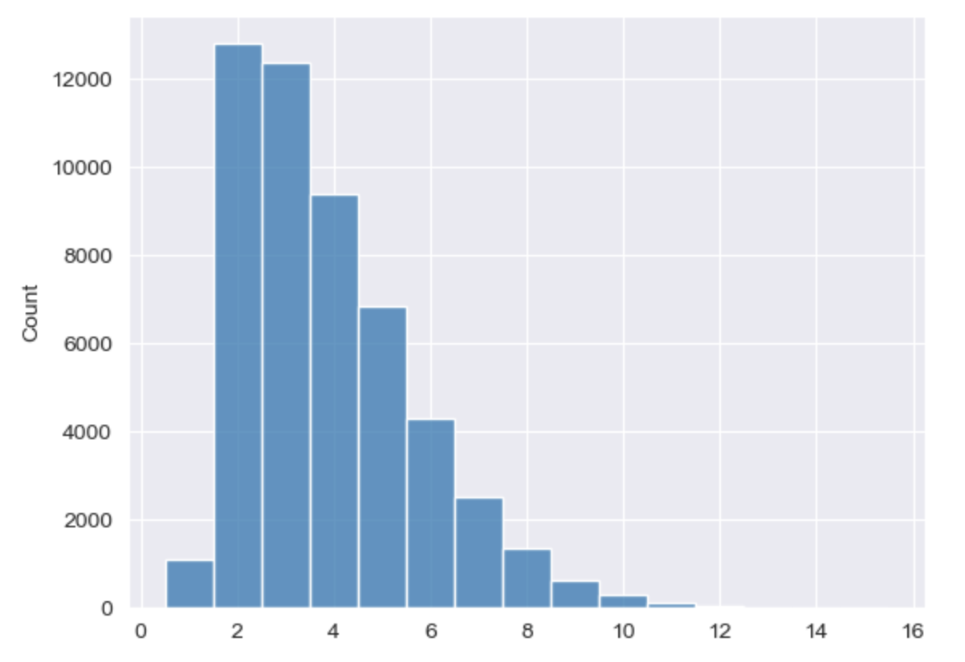
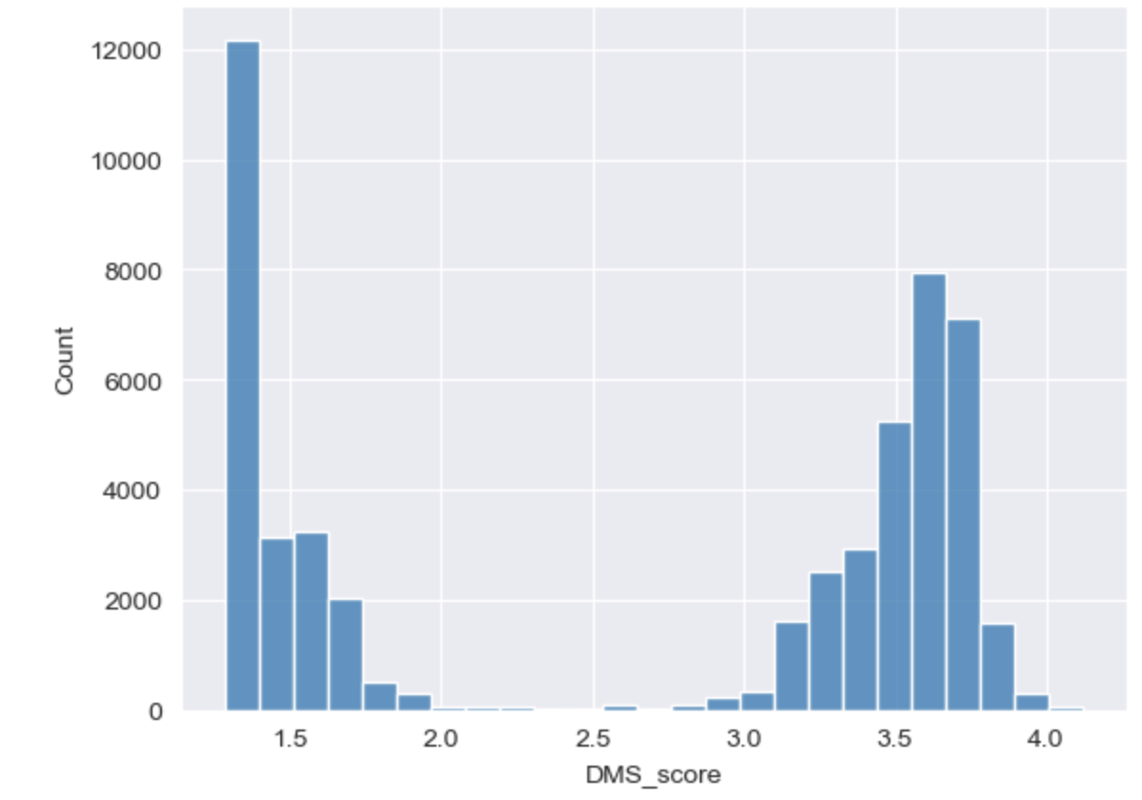
Our dataset visualized
Anzahl Mutationen
Anzahl Mutationen
Notes:
Now you know what we want to do with the data in theory, i try to explain with which methods and analysis we are planning to work
---------
This plot shows exactly this distribution, how many mutations the sequences have. (average of 3.7 mutations)
→ not as many single mutations (about 1000)
→ BUT chance to analyze the effect multiple mutations have on each other
---------
This plot shows the distribution of the fitness score across all sequences
the fitness- cut off was set at a DMS score of 2.5
------
you can already see that a lot of the mutants are not considered as fit due to their mutations
→ from a total of 50000 mutants, “only“ 30000 are declared as fit
→ makes no sense to try to explore „better“ versions of an almost perfect protein
→ big impact of multiple mutations on the fitness
NOW what do we want to try to do with our data:
------

Slide 8
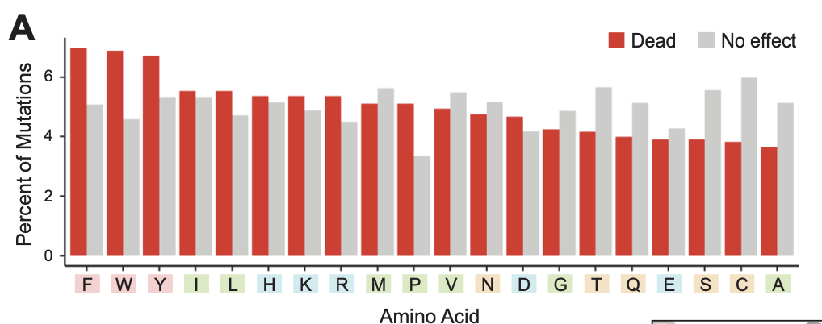
How we want to analyze our data
Exploratory data analysis:
→ analyzing certain features of the dataset
→ t-test: mutation count – fitness score
Analysing epistatic interactions → hotspot discovery
identifying stabilizing mutations (Epistasis)
Prediction models
→ linear regression
single mutation 1
deleterious
double mutation (I + II)
rescued
→ stabilized
Notes:
First step : get comfortable with python and the data set itself
--------
Analysis on certain features of the dataset:
→ percentage of mutations per amino acid
--------
→ looks something like this
→ doing plots and distributions for several attributes
F.e. :
Substitutions to certain AA -> effect on fitness score (all kind of mutations vs only single/double/…)
Substitutions to defined groups of AA + effect on fitness score (polar, unpolar, different charged, acid,…)
-------
t-tests:
is there a significant change in overall fitness between double and triple mutations etc.
→ there probably is a point where the proteins are just dead, caused by too much mutations?
------
roman already told you about the chance to explore epistatic effects on the dataset, due to the multiple mutations
→ maybe can use it to discover hotspots , different ideas to get information on which positions are important for the general fitness of the protein
-----
epistasis explaines the effect that two mutations, that are deletious or neutral on their own (as single mutations) can rescue each other and stabilze the protein again
identifying those mutations that have an stabilizing effect -> hint that they could have an important role → hotspot
------
idea to USE all of the collected data about the mutations that are prevalent for certain positions + the resulting fitness scores
trying to PREDICT FITNESS SCORES for mutated sequences that weren´t tested using linear regression
------
→ would include testing it on part of our own data , doing a control via correlation between the prediction and the actual data
All of this obviously depends on what information we gain during the process
But the presence of multiple mutations makes it most propable that we will be investigating in Epistasis and hopefully prediction models

Slide 9



 | Week 01 | Week 02 | Week 03 | Week 04 | Week 05 | Week 06 | Week 07 | Week 08 | Week 09
 | 22.05-28.05 | 29.05-04.06 | 05.06-11.06 | 12.06-18.06 | 19.06-25.06 | 26.06-02.07 | 03.07-09.07 | 10.07-16.07 | 17.07-19.07
Structure data
Pattern analysis
Further Analysis
Phylogeny
Further Analysis 3D-structur
GitHub repository
17.07
Presentation
19.07
Notes:
let's move on to the final part of our presentation -> In this last section, we will discuss the structure of our project and the timeline we have set.
Have 8 Weeks for this project -> starting from May 22nd until July 16th
The first two weeks we -> organizing the data and doing basic analysis, like extrama and minima, what have the stongest pos./neg. effect? → we want all to work on this equally and this will be our first milestone
Following that -> focus on pattern analysis -> goal identify interesting patterns such as hotspots and combinations of mutations→ Roman explainet to you that in detail before → we allocated for this phase around 4 weeks -> this will be our second milestone
Around week 4 to 5 -> expected to have more experience and knowledge in working with python -> work faster and efficiently
This is also the time when we except get interesting results that we can use for the phylogeny analysis → around week 5 →starting the phylogeny analysis (Evolutionary steps, site conservation, pairwise alignment/MSA → this will be our last milestone
Based on the status/progress of the project → we also doing the 3D structure analysis (combination of mutations, Decrease in size/mass, Long-range interaction) → but then we will split our team in two teams to work parallel on 3D-structure and phylogeny → work more efficient → aim to complete both 3D-structure and phylogeny by mid to late week 7
By mid to late week 7 want to begin → clean up our github Repository, write the read me file and prepare for our final presentation → both we need a week later
Since this is right before the exam phase → we split up in two teams → where 1 team is preparing the presentation and 1 team is cleaning up github repo and write the read me file → work faster, more efficiently, and distribute the responsibility evenly among the team members
As you see we don’t establish a ridig structure → instead foster a collaborative and equal environment → we think everyone have an intrinsic motivation to do the project very good
We hope you enjoyed our presentation and feel free to ask us questions.
We have approximately 8 weeks for the project, starting from May 22nd until July 16th. Initially, we will dedicate some time to organizing the data and conducting initial analyses. We have allocated two weeks for this task, and all four of us will work on it together. This will be our first milestone, where we aim to establish a solid foundation for the project.
Following that, as Roman mentioned earlier, we will focus on pattern analysis. Our goal will be to identify interesting patterns such as hotspots and combinations of mutations. We have allocated around 4 weeks for this phase. During this period, all team members will collaborate on the pattern analysis, and this will serve as our second milestone. By the end of week 4 to 5, we expect to have gained more experience and knowledge in working with Python, enabling us to work faster and more efficiently.
Starting from week 5, we will begin working in parallel on both the pattern analysis and the 3D structural analysis ( combination of mutations, Decrease in size/mass, Long-range interaction). All four of us will contribute to the 3D structure analysis, which will serve as our final milestone. Based on the status/ progress of the pattern analysis, we might also explore the phylogeny aspect (Evolutionary steps, site conservation, pairwise alignment/MSA) of the project. In that case, we will split our team into two groups, with two members focusing on the 3D structure and the other two on the phylogeny. Our aim is to complete both the 3D structure and phylogeny analysis by mid to late week 7.
Simultaneously, we will allocate time to clean up our GitHub repository, write the Readme file, and prepare our final presentation. We will have approximately 1 to 1 ½ weeks to complete these tasks. Since this aligns with the exam period, we will divide the work again, assigning two people to each task. This approach will allow us to work faster, more efficiently, and distribute the responsibility evenly among the team members.
We intentionally did not establish a rigid structure with a team leader because we believe it is not necessary. Instead, we will foster a collaborative and equal environment where everyone's opinions and contributions are valued.
We hope you enjoyed our presentation and feel free to ask us questions.
First gain general insights into the data + basic analysis
E.g. extrema and minima – which mutations have the strongest positive/negative effect?
Following that up, find trends for improvement of protein function/deterioration
Multiple levels of mutational effects due to multiple layers (amount of mutation) 1-12 mutationen
And identify the cause
Correlation between AA-properties (charge, hydrophilicity, size and mass) and the visible effect to the protein
Based off this, move to the analysis of mutational hotspots, so focussing on a region with interesting/clear mutational results.
Might also contain mutational patterns, which could cause an increased/decreased fitness of GFP
Special focus on the chromophore as a mutational site
Usage of extrema and dead-threshhold --> pymole to display structure

Slide 10
Epistasis
whether an amino acid that occurs at a given site makes an independent contribution to fitness, or whether its contribution depends on the state of other sites in the organism’s genom
→ Evolutionary predictions
Testing the influence of epistasis on fitness levels:
How much of the sample variance can be explained by a non-epistatic model?
→using a model, recording to the function of fitness potential (sum of the individual mutations) no epistasis
Epistasis: deviation from additivity of effects of single mutations
→ possible to „calculate“ the extent of epistasis in a combination of mutations
Notes:
The contribution a ceratin amino acid makes to the fitness of a protein
Either independent or depends on other sites

Slide 11
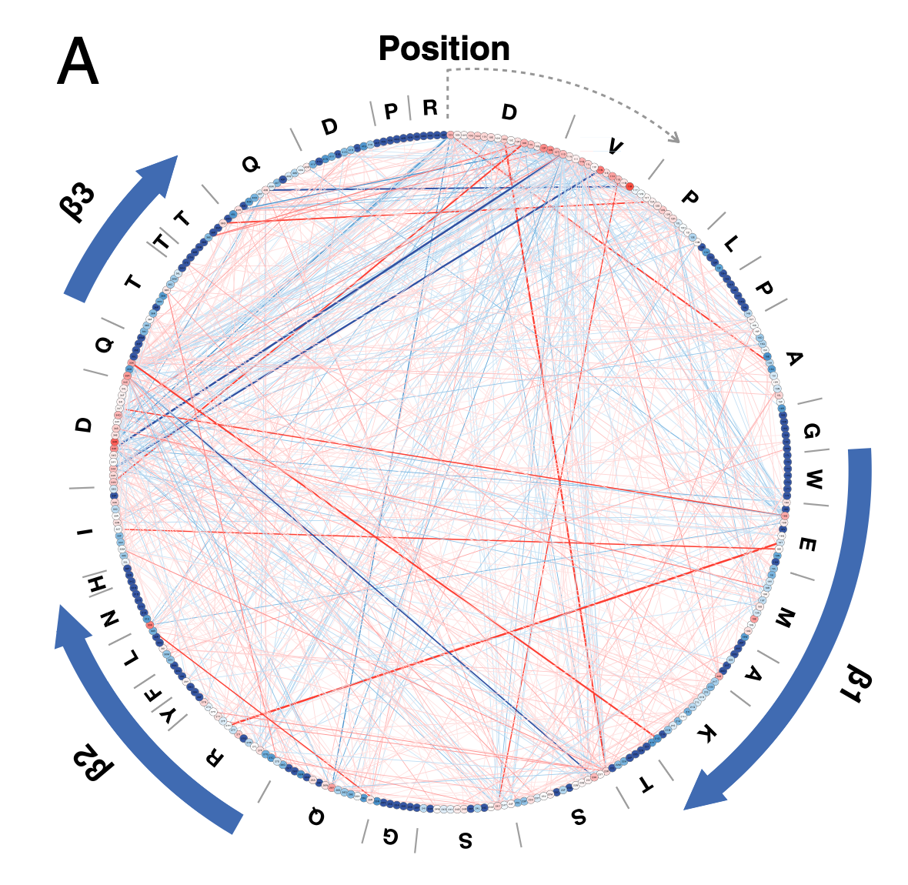
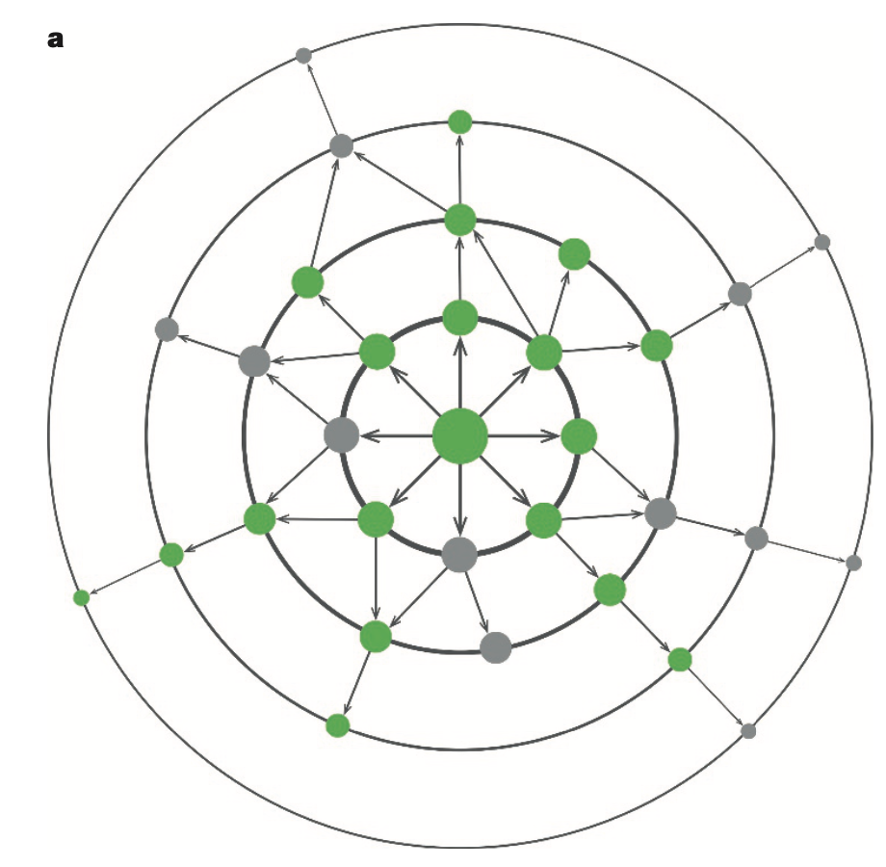
Epistasis
Grey: deleterious / negative
Green: positive / rescued

Slide 12
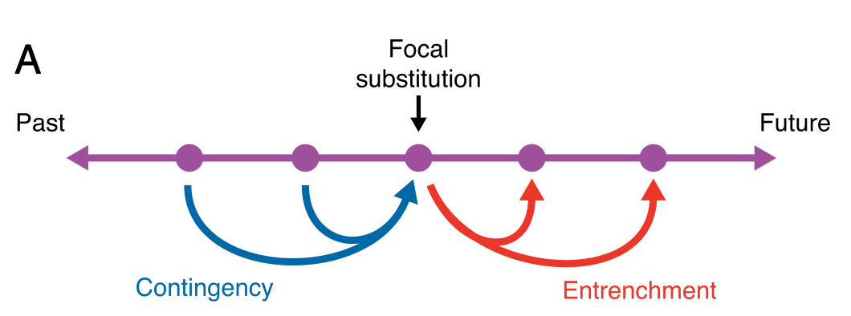
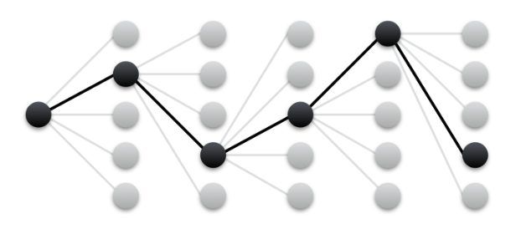
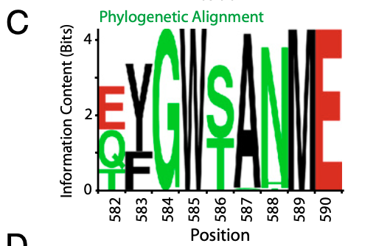
Epistasis and Phylogenie
Extent + distribution of epistasis in a protein : essential for phylogenie of the protein
amino-acid substitutions are typically contingent on the presence of prior substitutions
More known: Epistasis in adaptive evolution
Analyzing it´s impact on purifying evolution
Sequence alignment (blast) : information about conserved positions (→importance)

Slide 13
Linear regression →prediction models
Predicting a value, based on the value of other variables
Fit a predictive model on an observed dataset (explanatory values + response values)
If we have more explanatory data than response
→ More possible mutation combinations but no observed fitness score
Fitted model can make predictions based on the explanatory data
Finding the best-fitted line that describes the data
→ Determined by minimizing the sum of the squared differences between the predicted and actual values

Slide 14
T-tests
Significance of the difference between group means
t-score: ratio between the difference between two groups and the difference within the groups
Larger t scores = more difference between groups.
Smaller t score = more similarity between groups.
P-value: to the t-score, probability that the results from your sample data occurred by chance
→ Low p-values indicate your data did not occur by chance
Example: comparing the mean fitness scores of to groups (substitutions to a specific AA f.e.)
Notes:
Is the difference between the groups statistically relevant?

